Slide 1
Pipeline Health Monitor
An AI-Powered Recruitment Automation Workflow · Built on n8n
Workflow Documentation & Enhancement Guide

Slide 2
Executive Summary
Automated recruitment pipeline monitoring using n8n workflow automation.
Pulls live data from Google Sheets (Applicants, Interview Feedback, Historical Data).
AI agents powered by Mistral Cloud & GPT-4o via OpenRouter assess every candidate.
Identifies "stalled" candidates stuck more than 7 days in any pipeline stage.
Routes healthy vs. stalled candidates to different downstream actions.
Spawns a Recruit Strategizer sub-workflow that emails HTML strategy reports.
Fully fault-tolerant – dedicated error-handler AI agents log errors & send alerts.

Slide 3
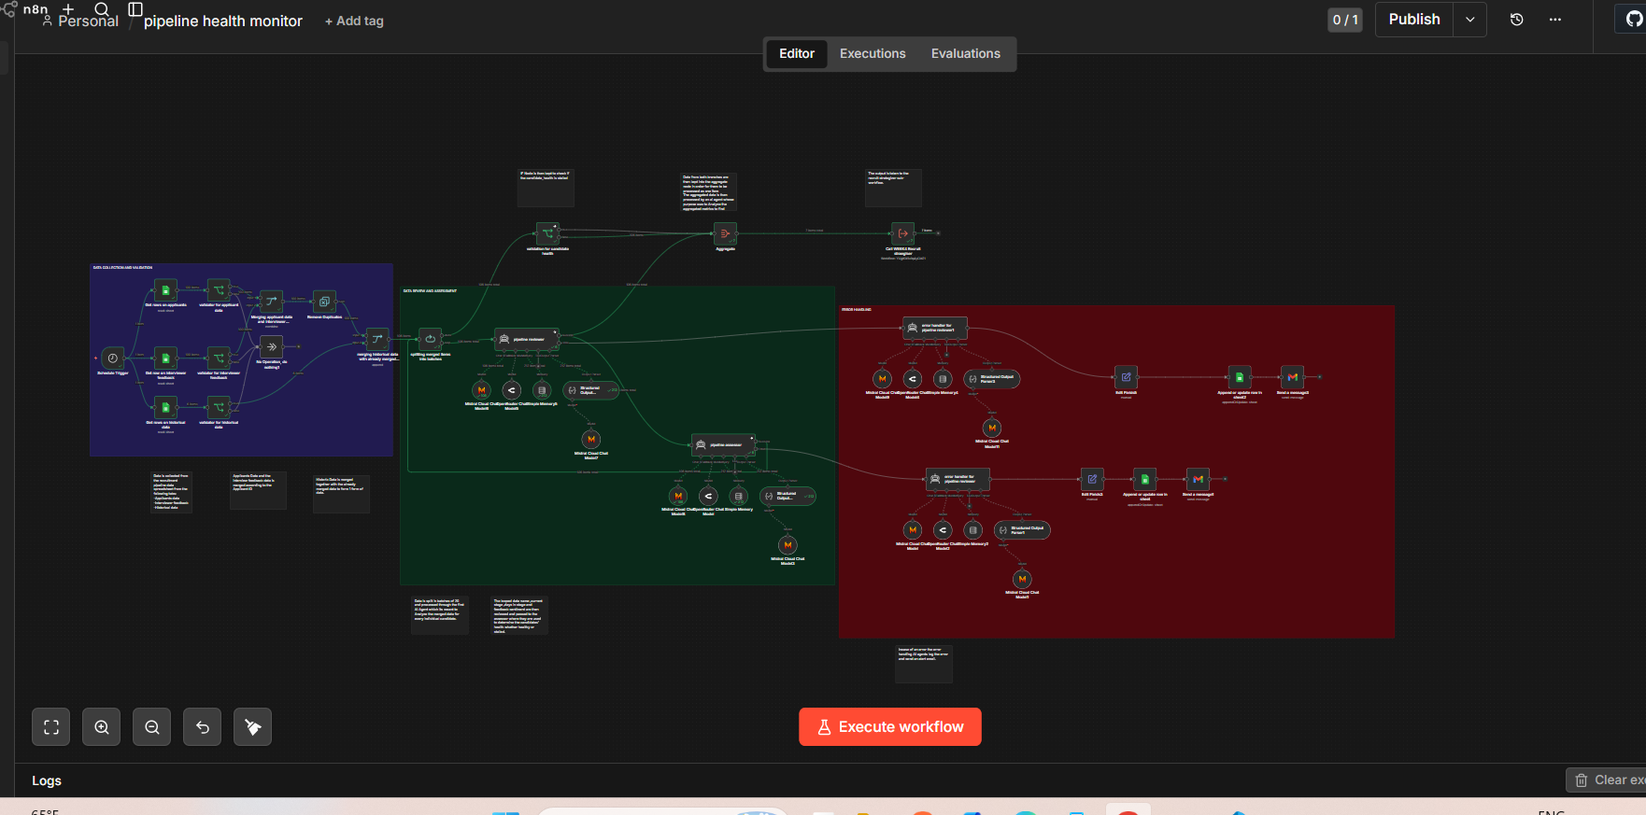

Slide 4
📥
Stage 1 – Data Collection & Validation
Pulling live recruitment data from Google Sheets

Slide 5
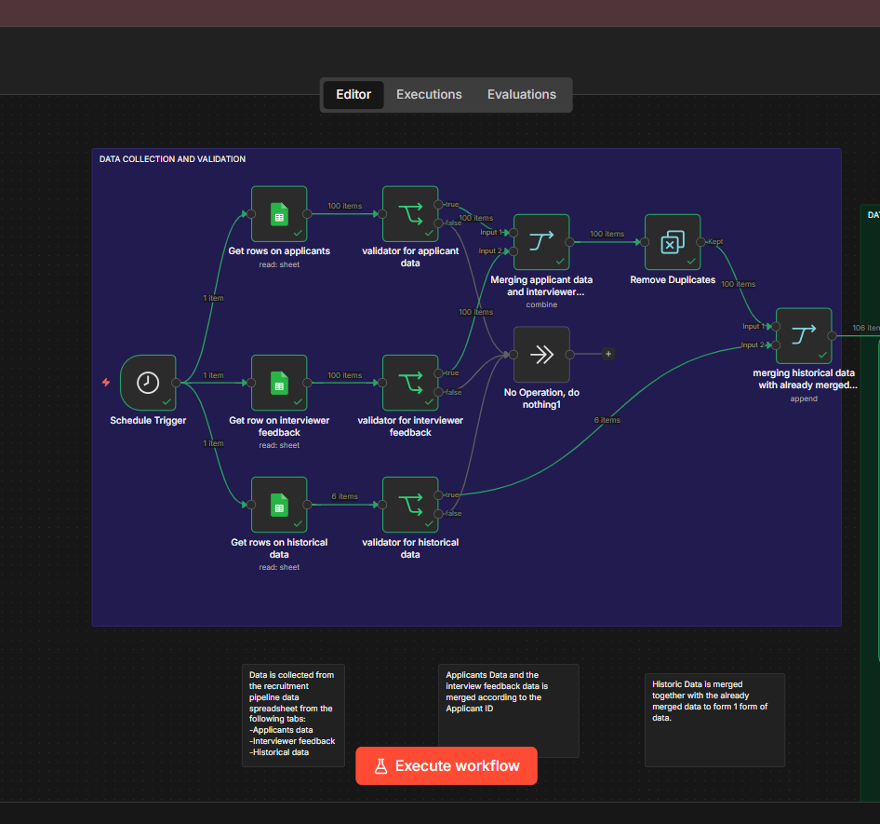

Slide 6
Data Sources – Three Google Sheets Tabs
Applicants Tab
Interview Feedback Tab
Historical Data Tab
Stores candidate name, current pipeline stage, days in stage, and status. Fetched first by the Schedule Trigger.
Holds interviewer notes and feedback sentiment per applicant ID, matched during the merge step.
Contains past-cycle hiring metrics used as benchmarks for assessing current candidate health and stage velocity.

Slide 7
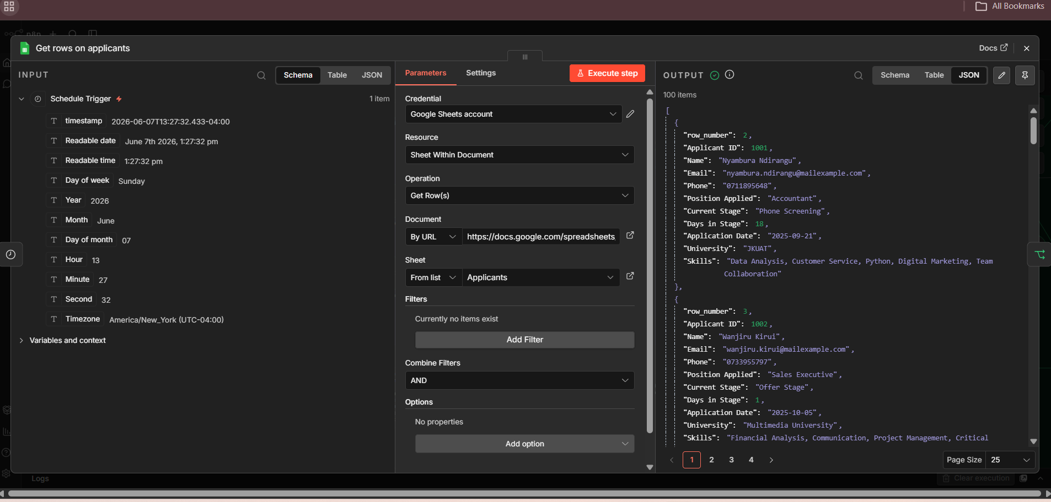

Slide 8
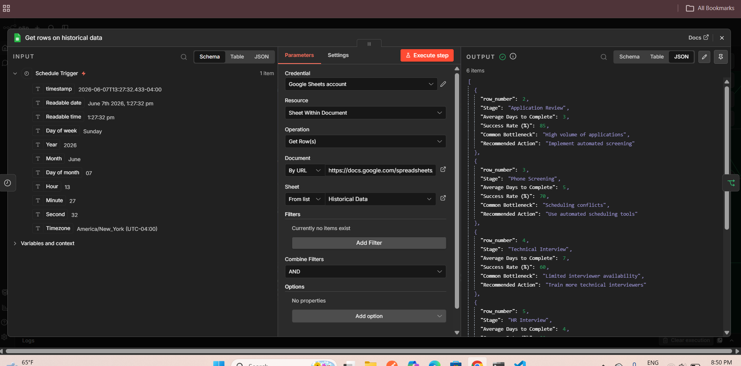

Slide 9
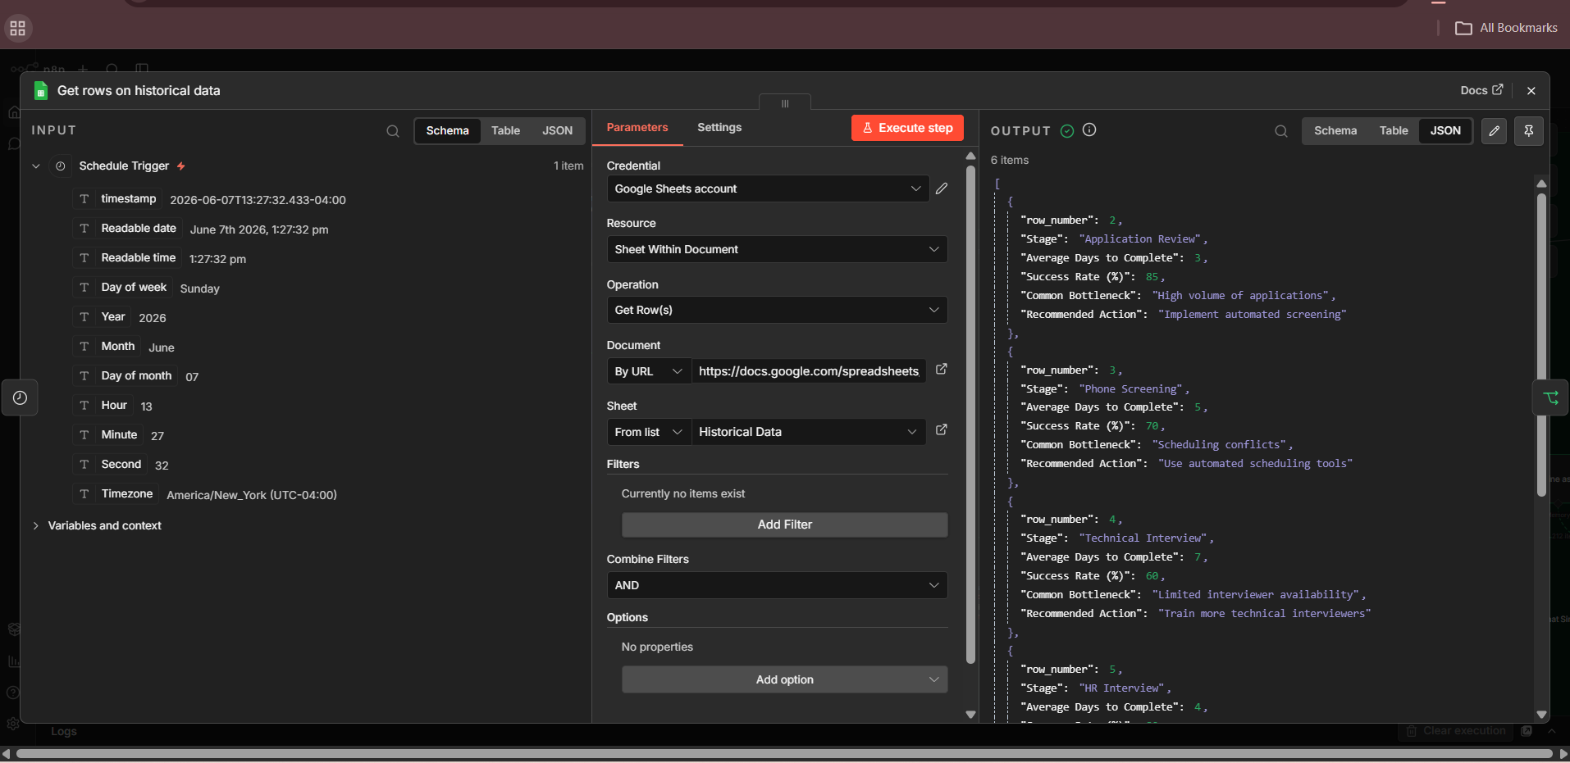

Slide 10
Workflow Trigger – Schedule Node
Schedule Trigger Node
Why Monthly?
• Type: n8n-nodes-base.scheduleTrigger
• Interval: Monthly recurrence
• Fires the workflow automatically at the start of each recruitment cycle
• Simultaneously triggers all three data-fetch nodes in parallel
Recruitment pipelines typically move on monthly review cadences. A monthly trigger ensures the workflow aligns with HR reporting cycles and generates actionable insights before the next hiring committee meeting.

Slide 11
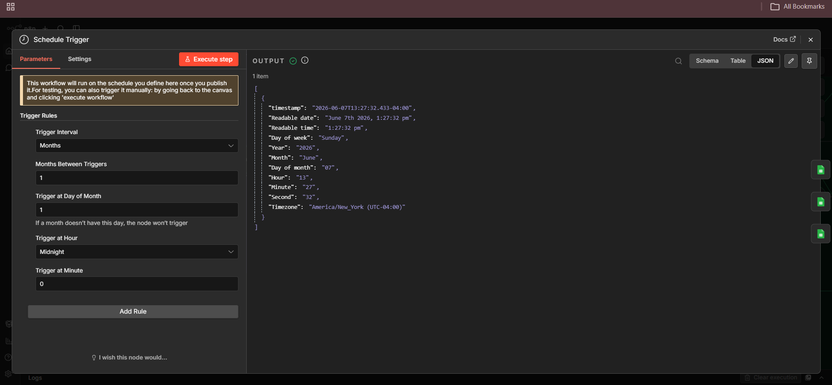

Slide 12
Data Validation – Three Gatekeeper IF Nodes
Validator: Applicant Data
Validator: Interview Feedback
Validator: Historical Data
Checks that required fields (Name, Stage, Days) are present and non-empty before allowing data to proceed to merge.
Ensures each feedback record has an Applicant ID and sentiment score. Incomplete records are routed to a no-op fallback.
Confirms historical benchmarks are available. If missing, the remove-duplicates step prevents stale or duplicate records from polluting analysis.

Slide 13
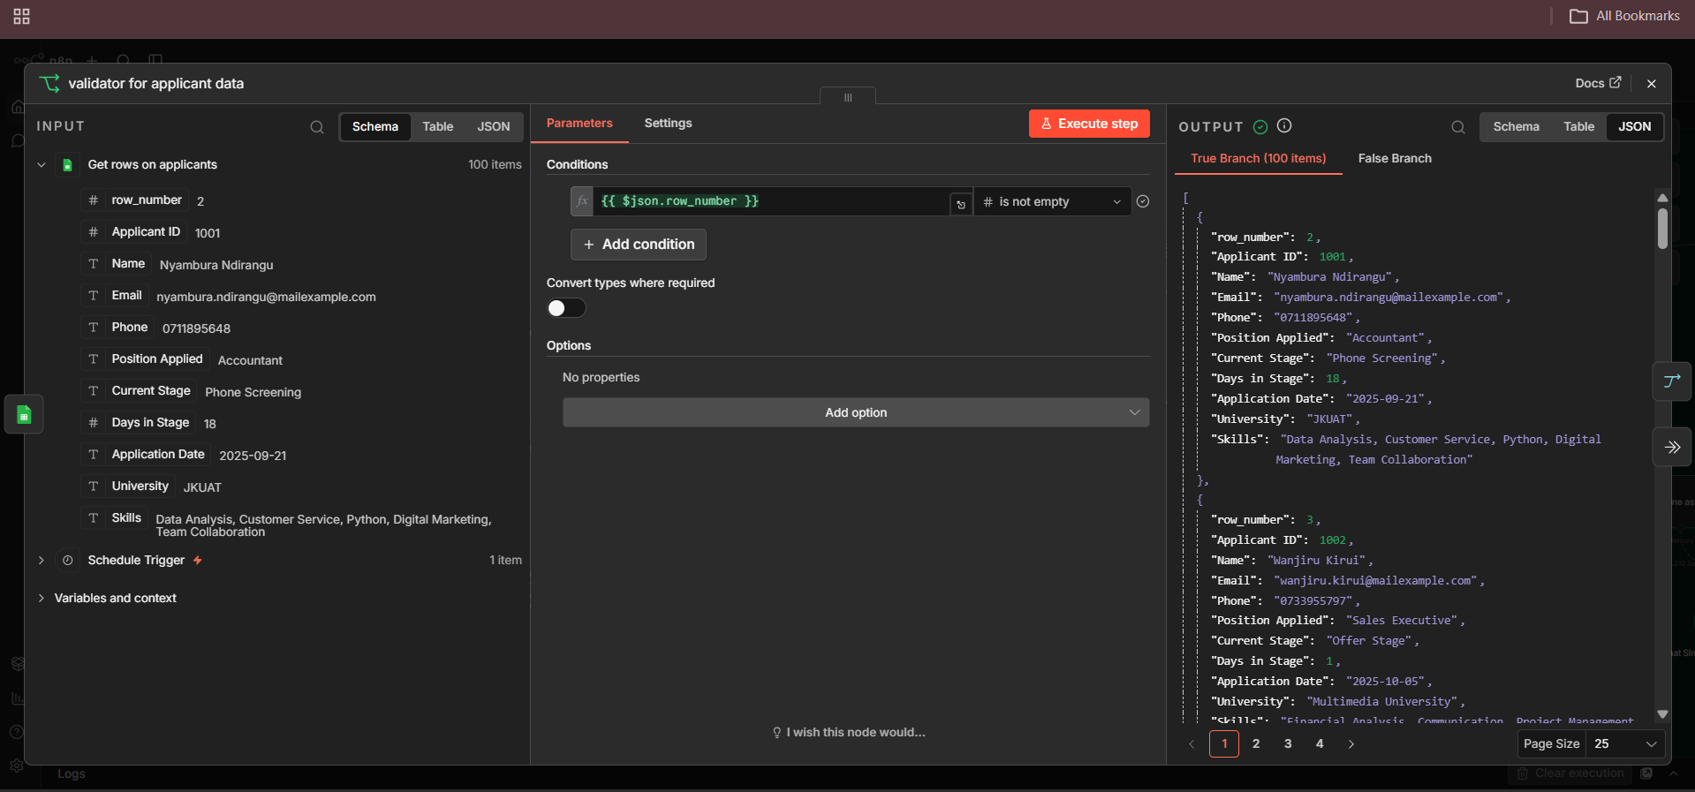

Slide 14
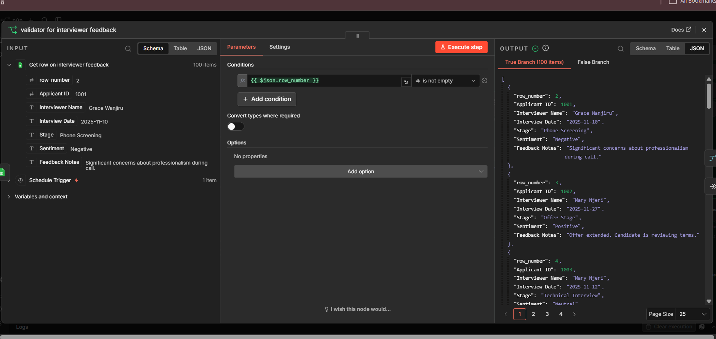

Slide 15
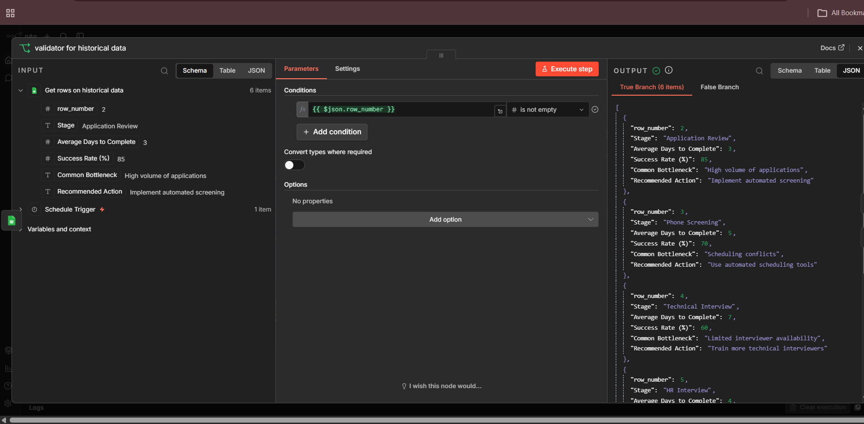

Slide 16
🔀
Stage 2 – Data Merging & Deduplication
Combining three data streams into one unified candidate record

Slide 17
Three-Step Merge Pipeline
1
2
3
Merge: Applicants + Feedback
Remove Duplicates
Merge: Combined + Historical
Applicant records joined with interview feedback using Applicant ID as the key. Creates a combined candidate profile.
Deduplication node strips any candidate appearing more than once across data sources before historical merge.
Historical benchmark data merged to complete the full picture. Output feeds directly into the batch splitter.

Slide 18
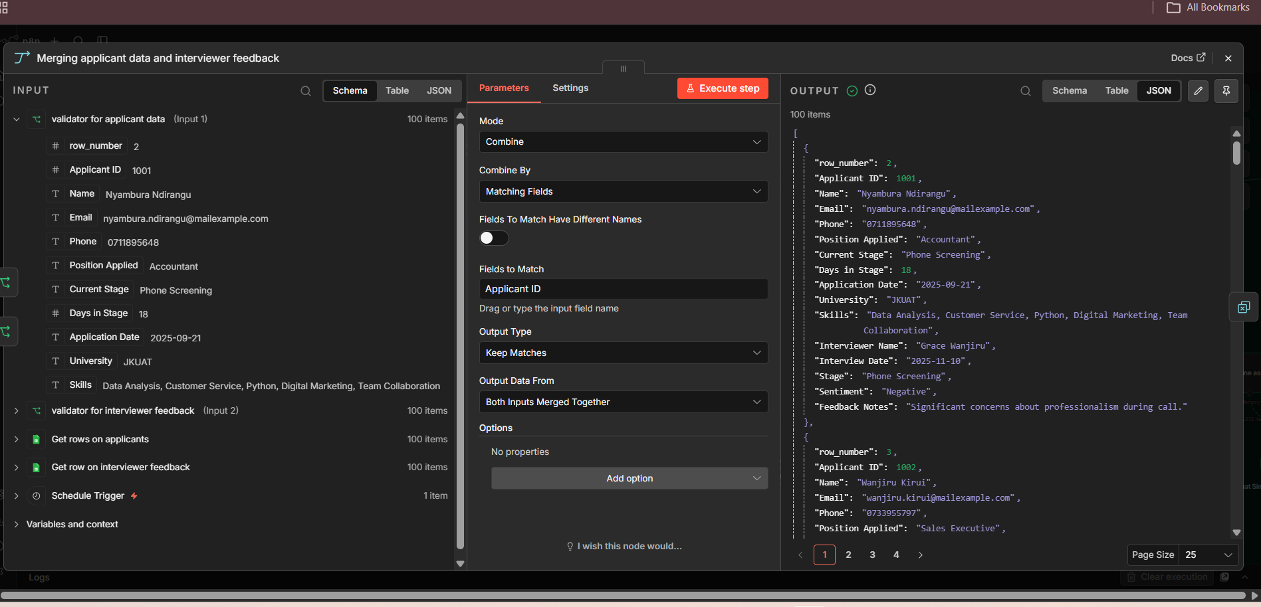

Slide 19
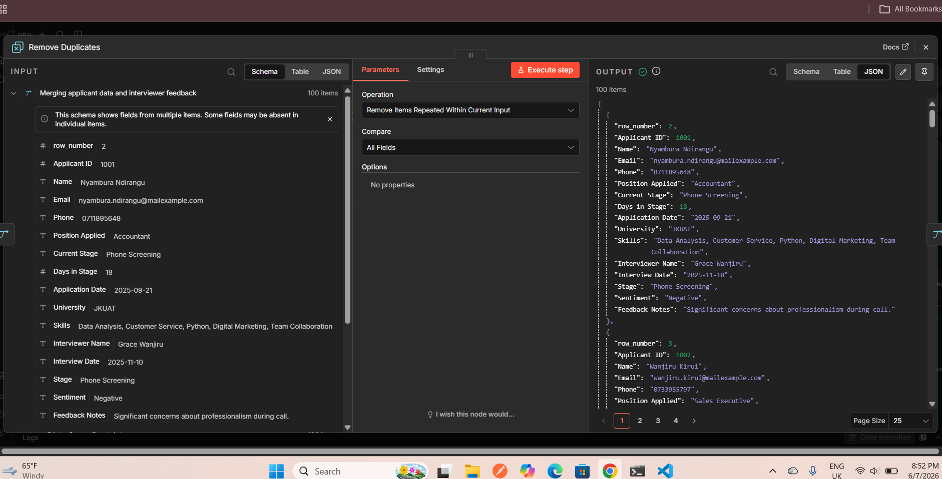

Slide 20
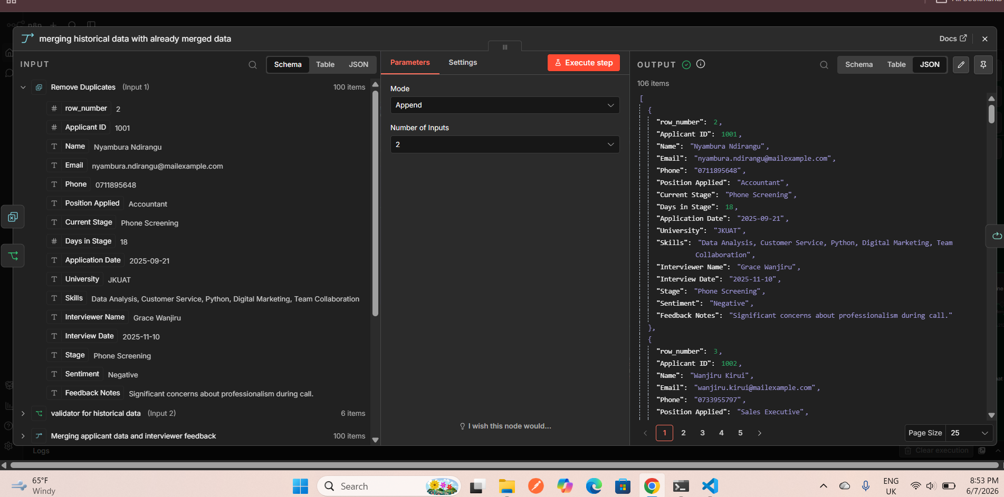

Slide 21
🤖
Stage 3 – AI Agent Assessment
Two-layer AI analysis using Mistral & GPT-4o with fallback routing

Slide 22
Batch Processing → Pipeline Reviewer Agent
Split in Batches Node
Pipeline Reviewer Agent
• Splits all merged candidate records into batches of 20
• Prevents memory overload during AI processing
• Each batch is independently processed through the reviewer agent
• Ensures consistent throughput even for large pipelines
Role: Recruitment Manager AI
Input per candidate:
• Name
• Current Stage
• Days in Stage
• Feedback Sentiment
Outputs structured JSON:
name | current stage | days in stage | feedback sentiment

Slide 23
AI Model Architecture – Dual Fallback Design
Primary: Mistral Cloud
Fallback: OpenRouter GPT-4o
devstral-medium-latest
openai/gpt-4o via OpenRouter
Temperature 0.3 | Max Tokens 100
Safe mode: OFF
Max retries: 2
Used for structured, deterministic output
Temperature 0.3 | Max Tokens 100
Activates automatically if Mistral fails
Ensures zero downtime on AI assessments
Memory: Buffer Window
Output Parser
Simple Memory – 25 turns
Structured Output Parser
Session key: current timestamp
Maintains conversation context within each batch run
Reset per workflow execution
Enforces strict JSON schema output
autoFix: true – self-repairs malformed AI responses
Powered by a secondary Mistral model

Slide 24
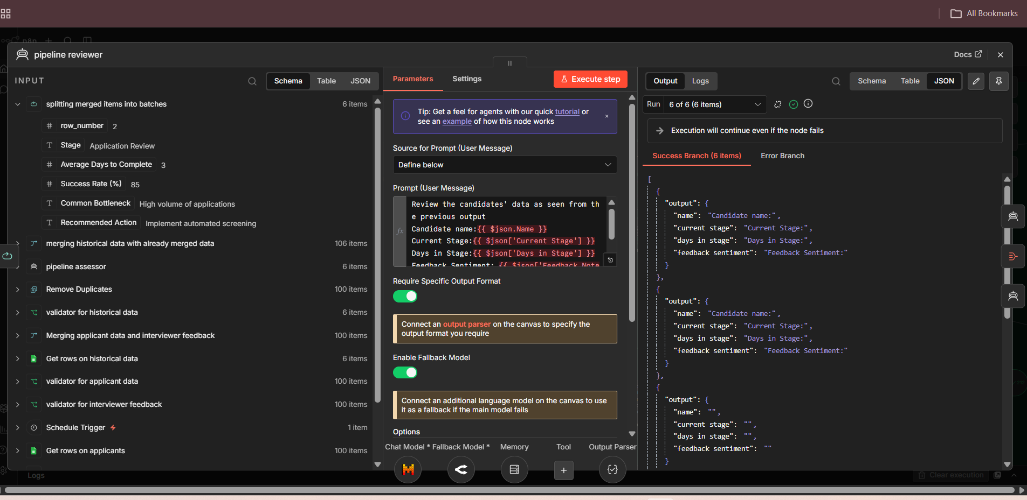

Slide 25
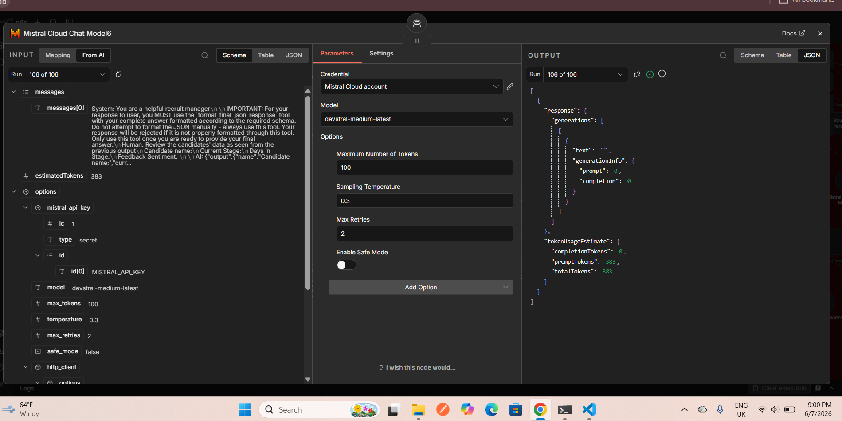

Slide 26
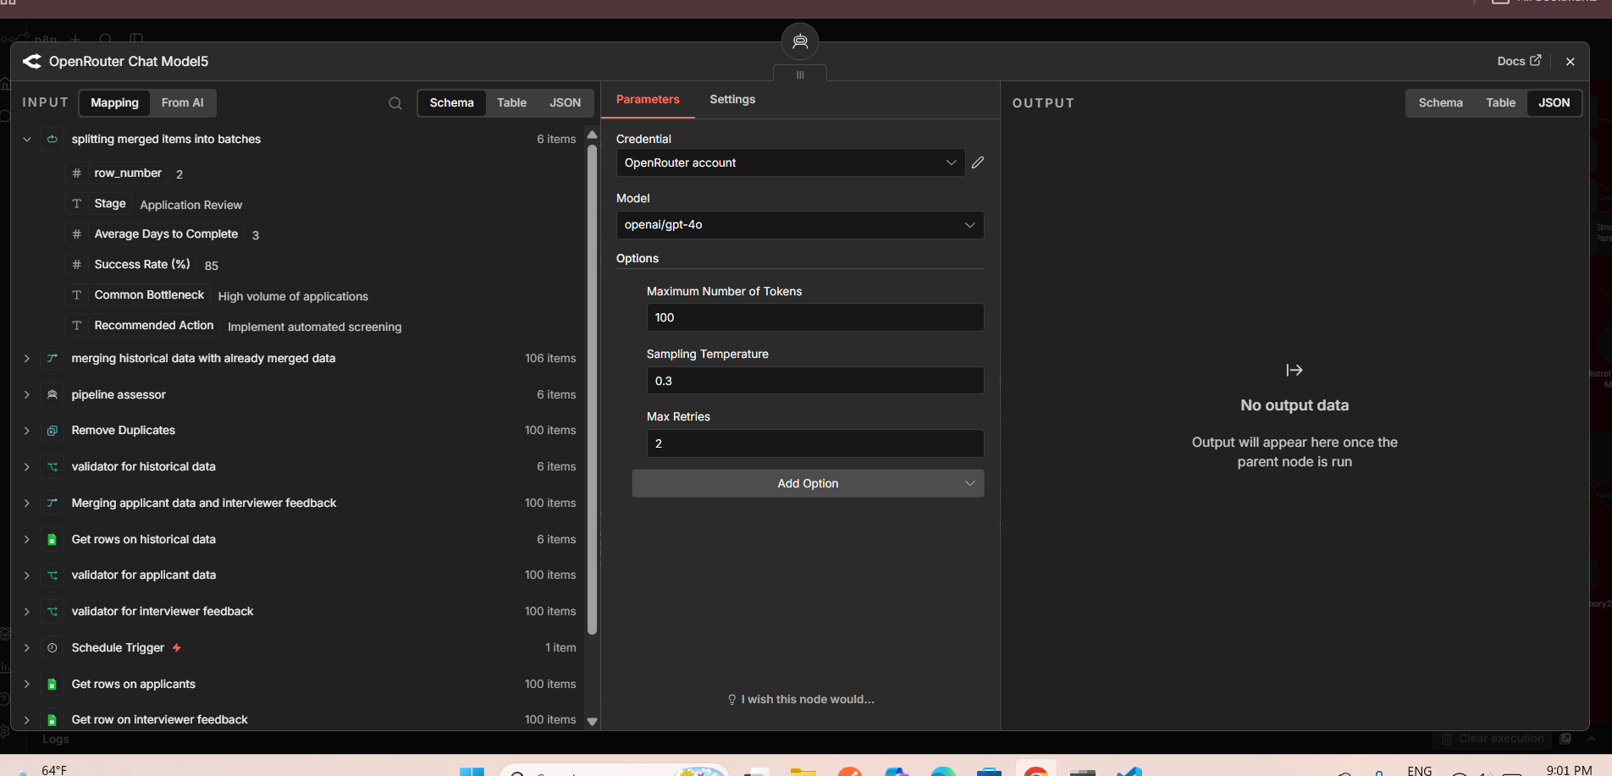

Slide 27
Pipeline Assessor Agent – Health Classification
Pipeline Assessor Logic
The assessor receives the reviewer's structured output and applies two evaluation rules:
Rule 1 – Stall Detection: Is the candidate stuck? Days in stage > 7 = STALLED
Rule 2 – Feedback Alignment: Is feedback sentiment consistent with the current pipeline stage?
Output label: 'stalled' OR 'healthy'
This binary classification drives all downstream routing decisions in the workflow.

Slide 30
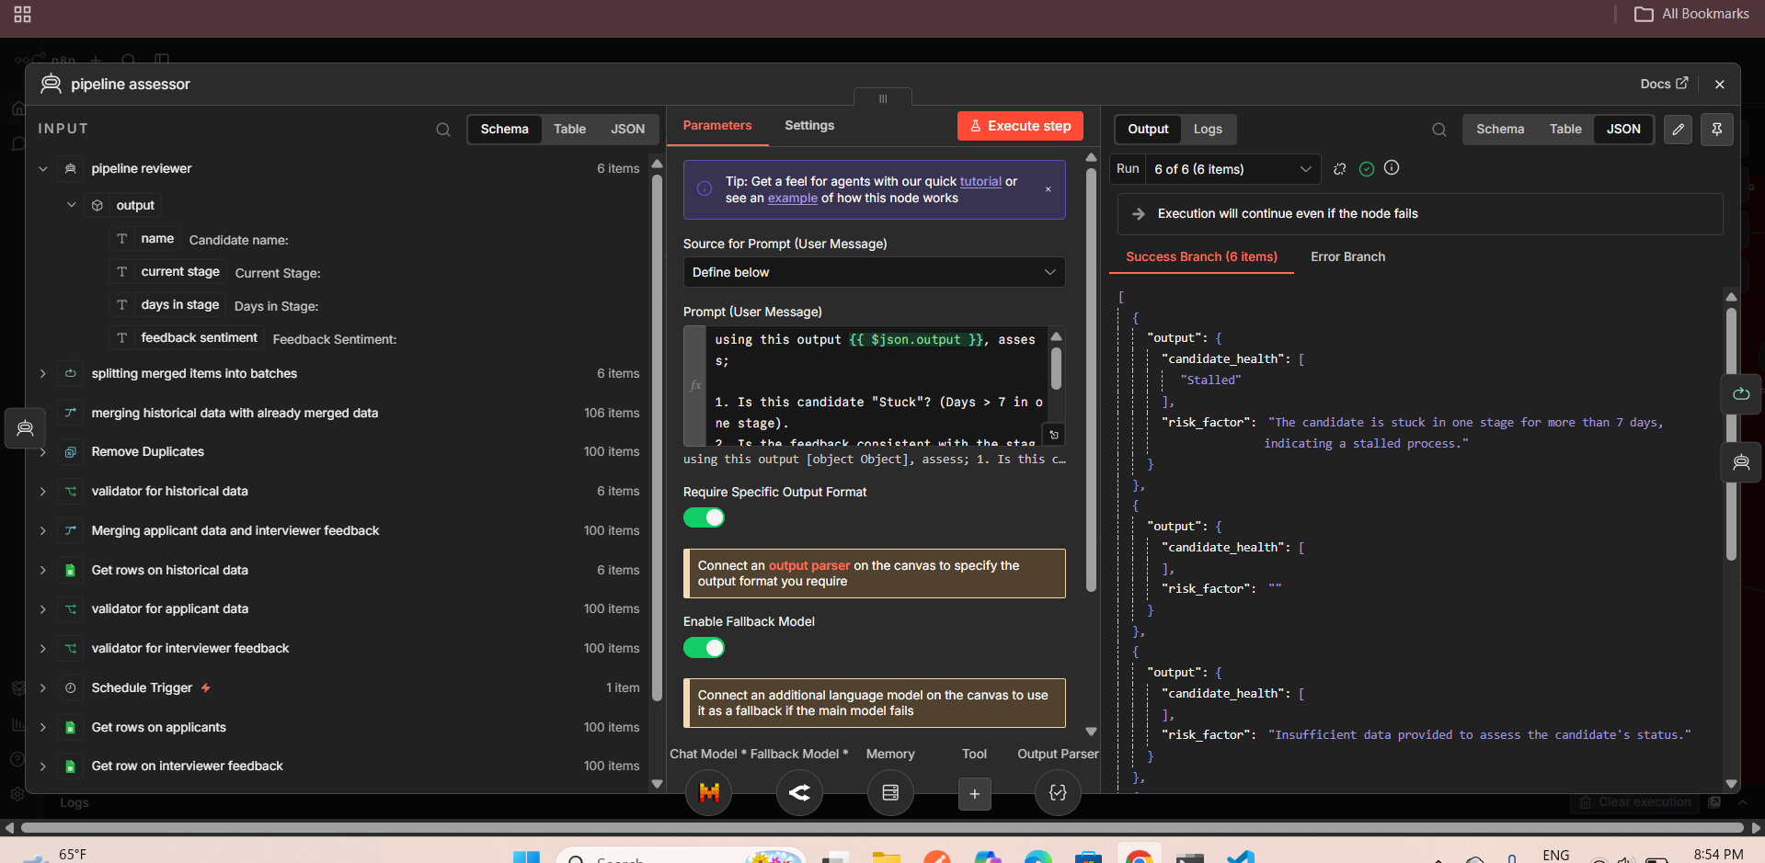

Slide 31
📤
Stage 4 – Routing & Downstream Actions
Conditional routing, Google Sheets logging, and email alerts

Slide 32
Candidate Health Routing – IF Node Decision Tree
✅ HEALTHY Path
⚠️ STALLED Path
Candidate is progressing normally.
• Data aggregated into the Aggregate node
• Passed to the Recruit Strategizer sub-workflow
• Strategy analysis & recommendations generated
• HTML report emailed to HR team
Candidate flagged as stuck (> 7 days in stage).
• Edit Fields node formats alert data
• Gmail node sends immediate alert email
• Google Sheet (Append/Update Row) logs the stalled record
• Error handler agents activated if step fails

Slide 33
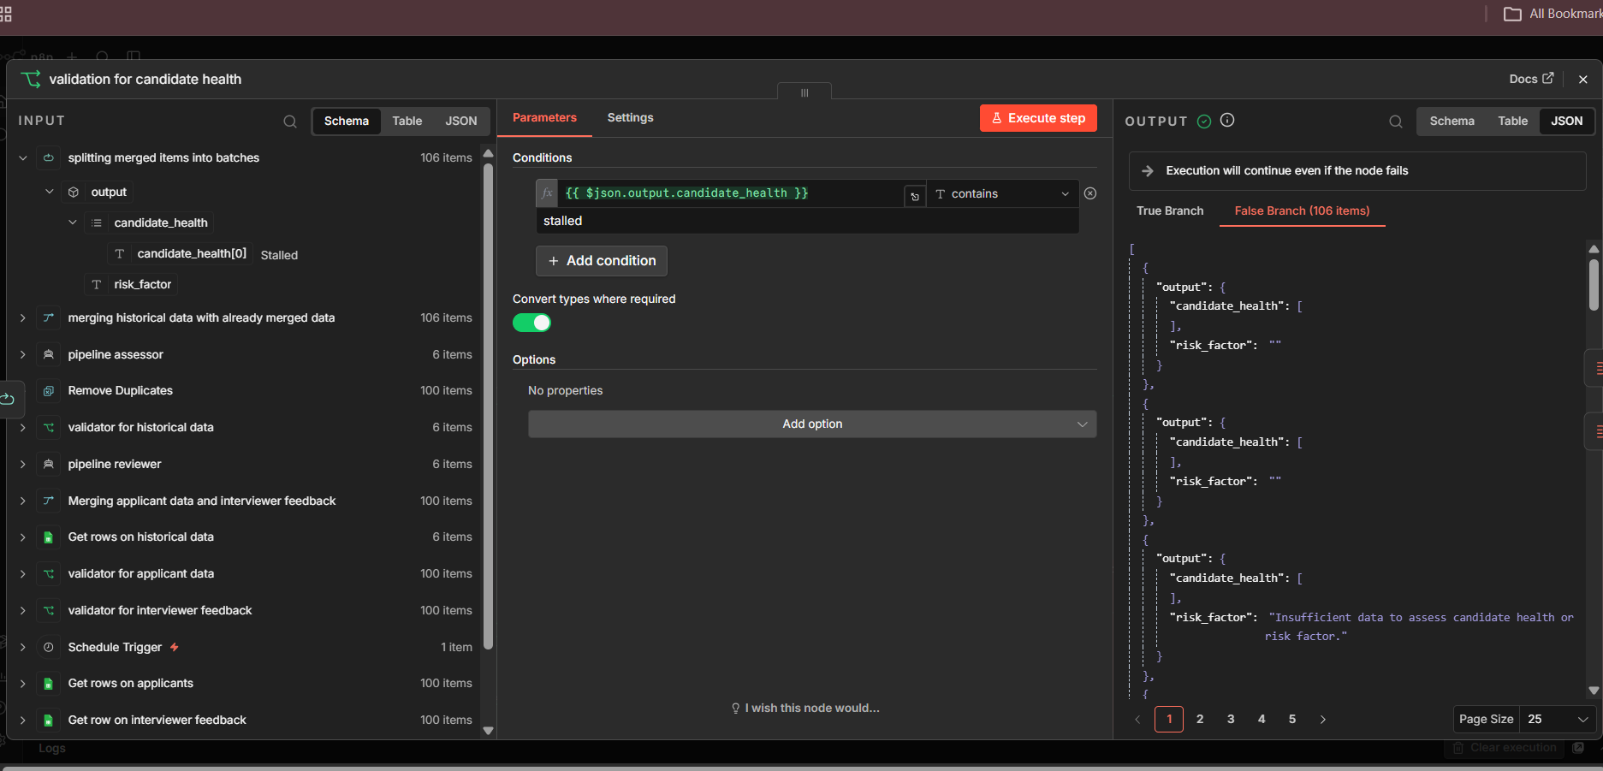

Slide 34
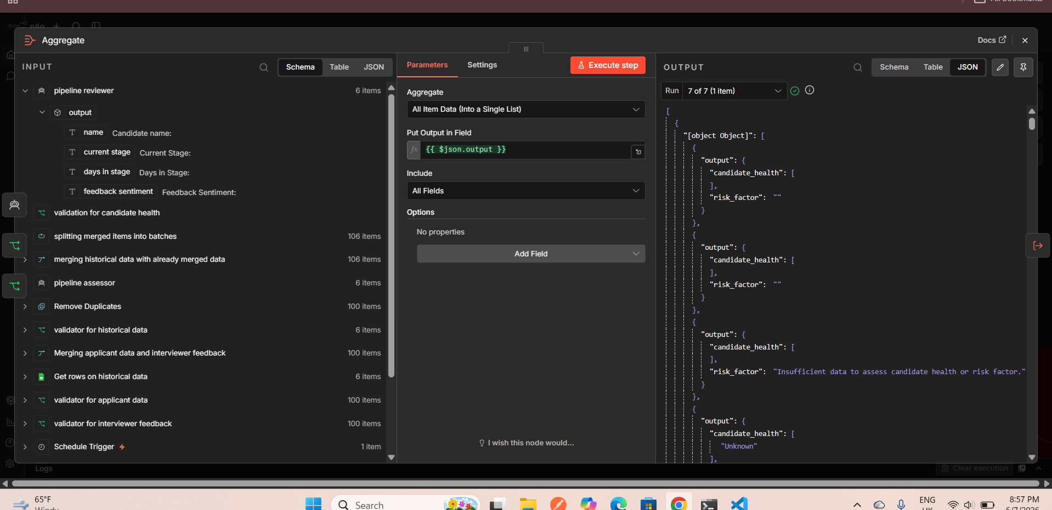

Slide 35
📊
Stage 5 – Recruit Strategizer Sub-Workflow
AI-generated bottleneck analysis and hiring improvement recommendations

Slide 36
Recruit Strategizer – AI Analysis Agent
Recruitment Strategiser Agent
Email Delivery
Triggered by: Call WEEK4 Recruit Strategiser (executeWorkflow node)
Input: Aggregated pipeline metrics from the main workflow
AI Tasks:
1. Identify bottleneck stage (Interview / Offer / Screening)
2. Generate 4 recommendations to improve hiring speed
3. Format output as valid HTML (lists + bold highlights)
Output Schema: Title | Text | Bottleneck Stage | Recommendations
Gmail node sends HTML strategy report to HR manager with bottleneck stage + action items highlighted.
Sheet Logging
Results appended or updated in Google Sheets for historical tracking of strategy recommendations.

Slide 37
Error Handling Architecture – Three Layers of Protection
Error Handler: Pipeline Reviewer
Error Handler: Pipeline Reviewer (Fallback)
Error Handler: Recruitment Advisor
Catches failures in the pipeline reviewer agent. AI reviews the error, adds a timestamp, and emails an alert. Logs event to Google Sheets.
Secondary fallback for the reviewer path. Same error-review logic using a Mistral + OpenRouter dual-model setup with structured output.
Guards the Recruit Strategizer sub-workflow. Sends alert email with subject 'Error in n8n AI agent' when strategizer fails.

Slide 38
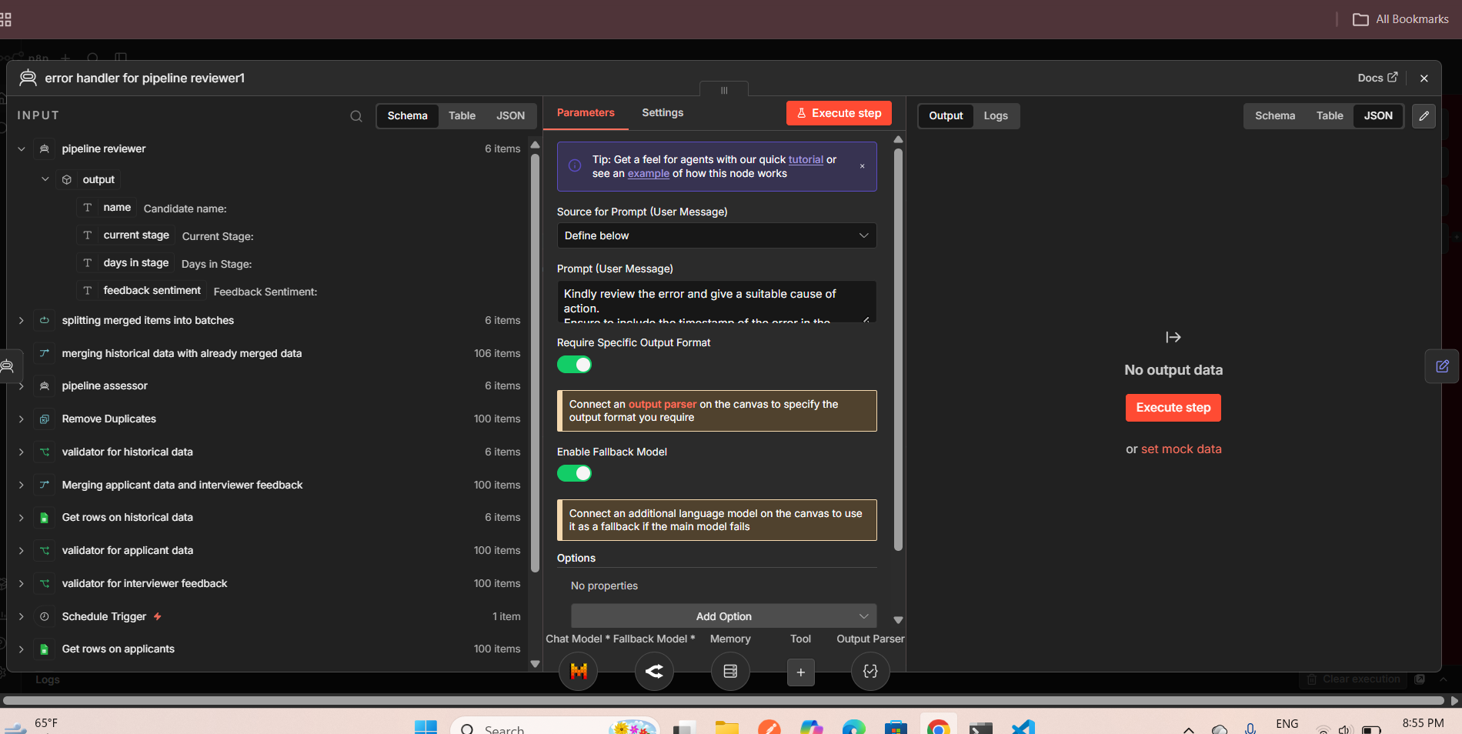

Slide 39
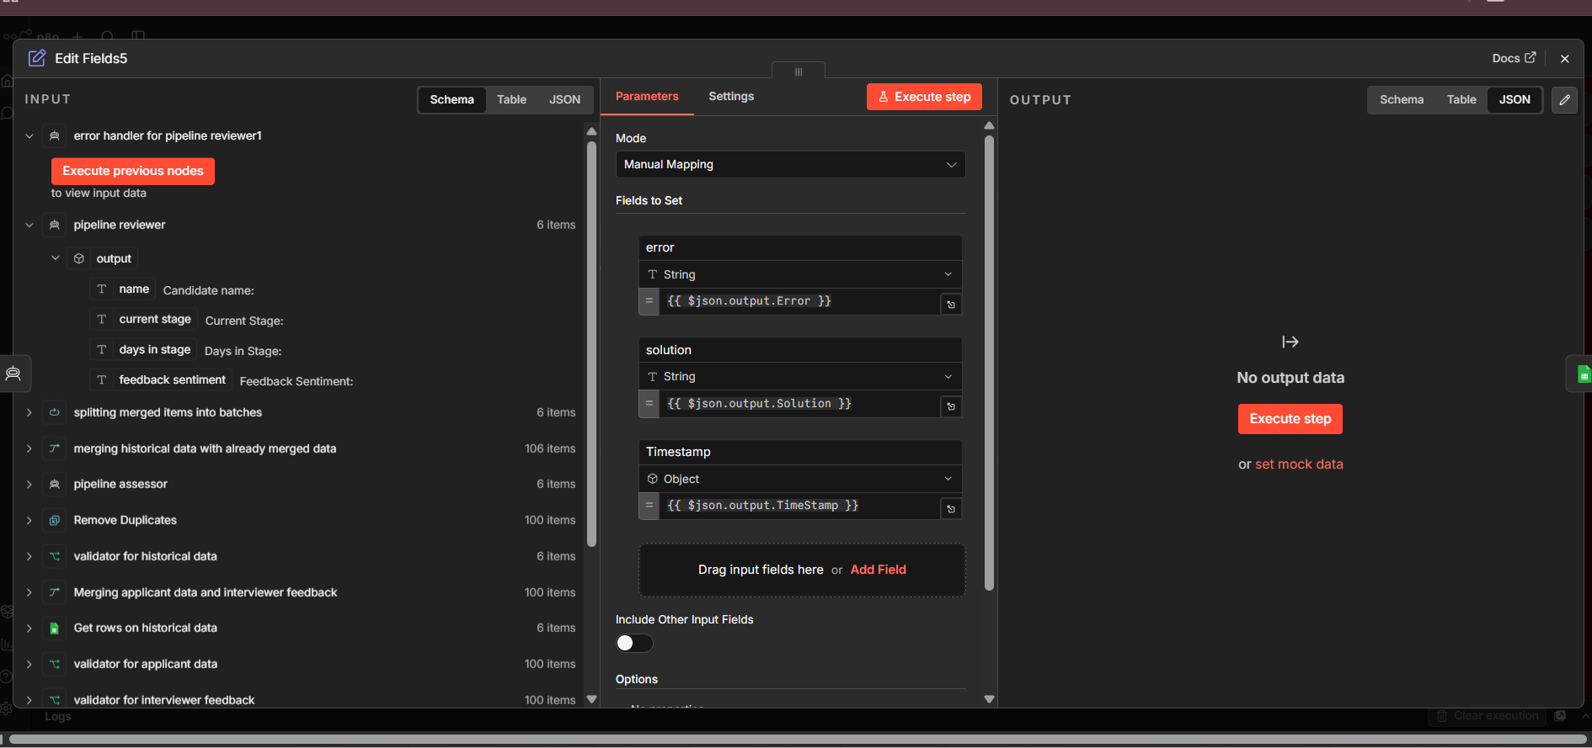

Slide 40
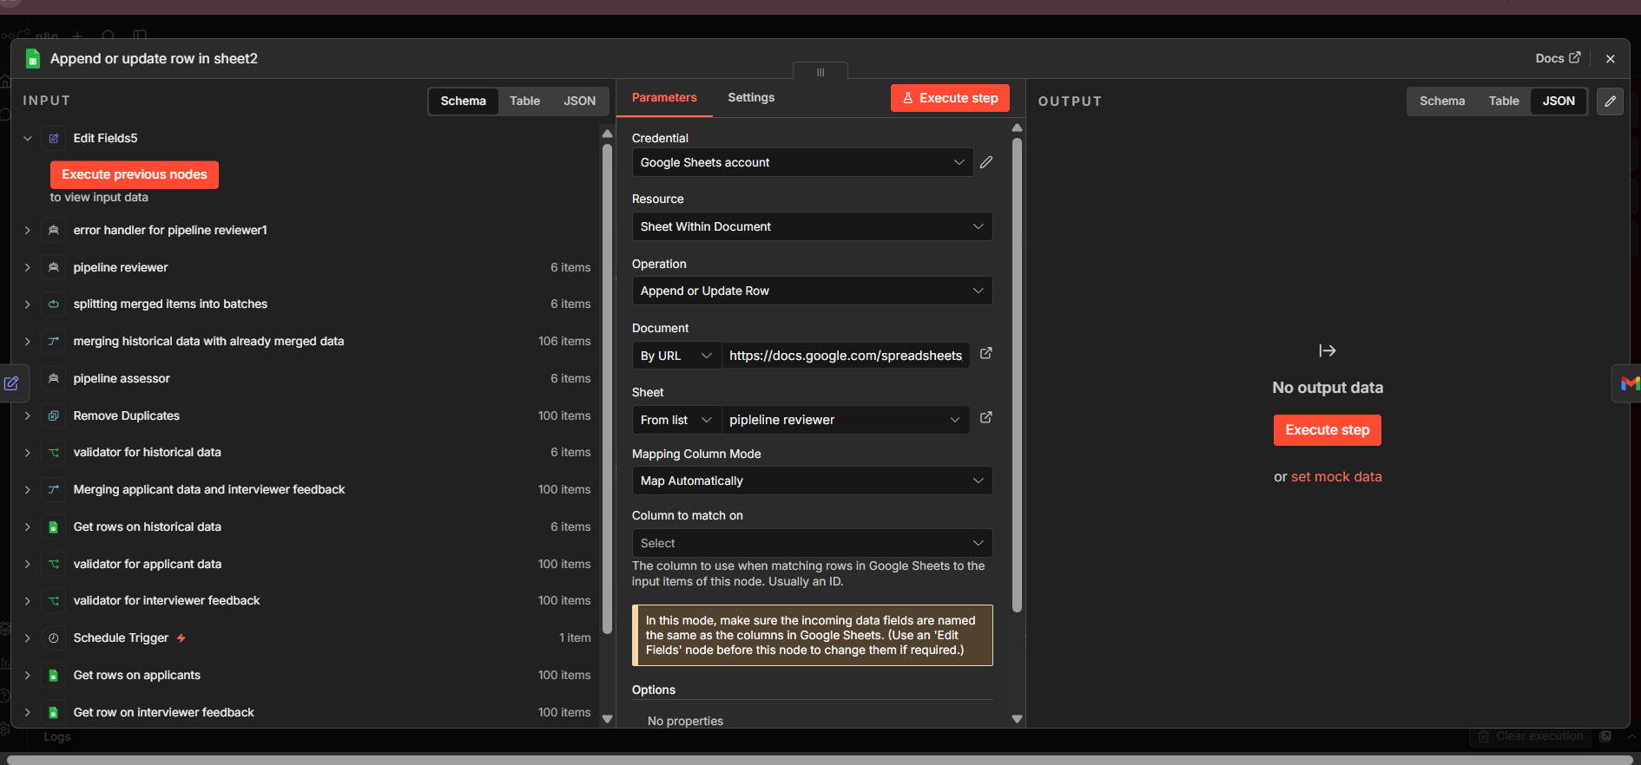

Slide 41
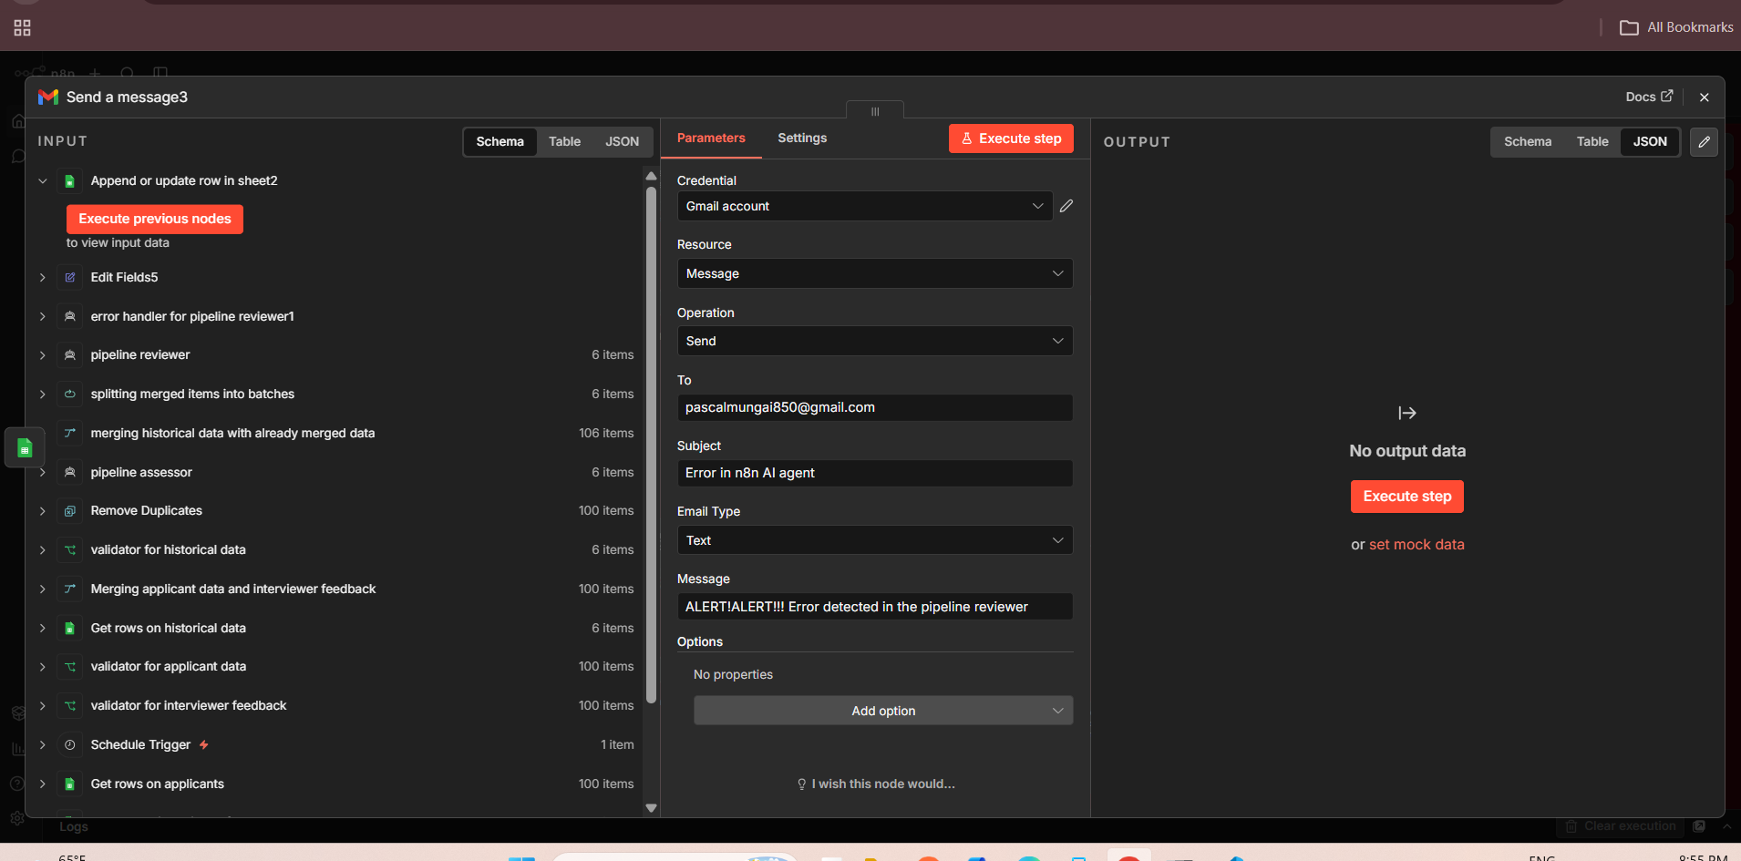

Slide 42
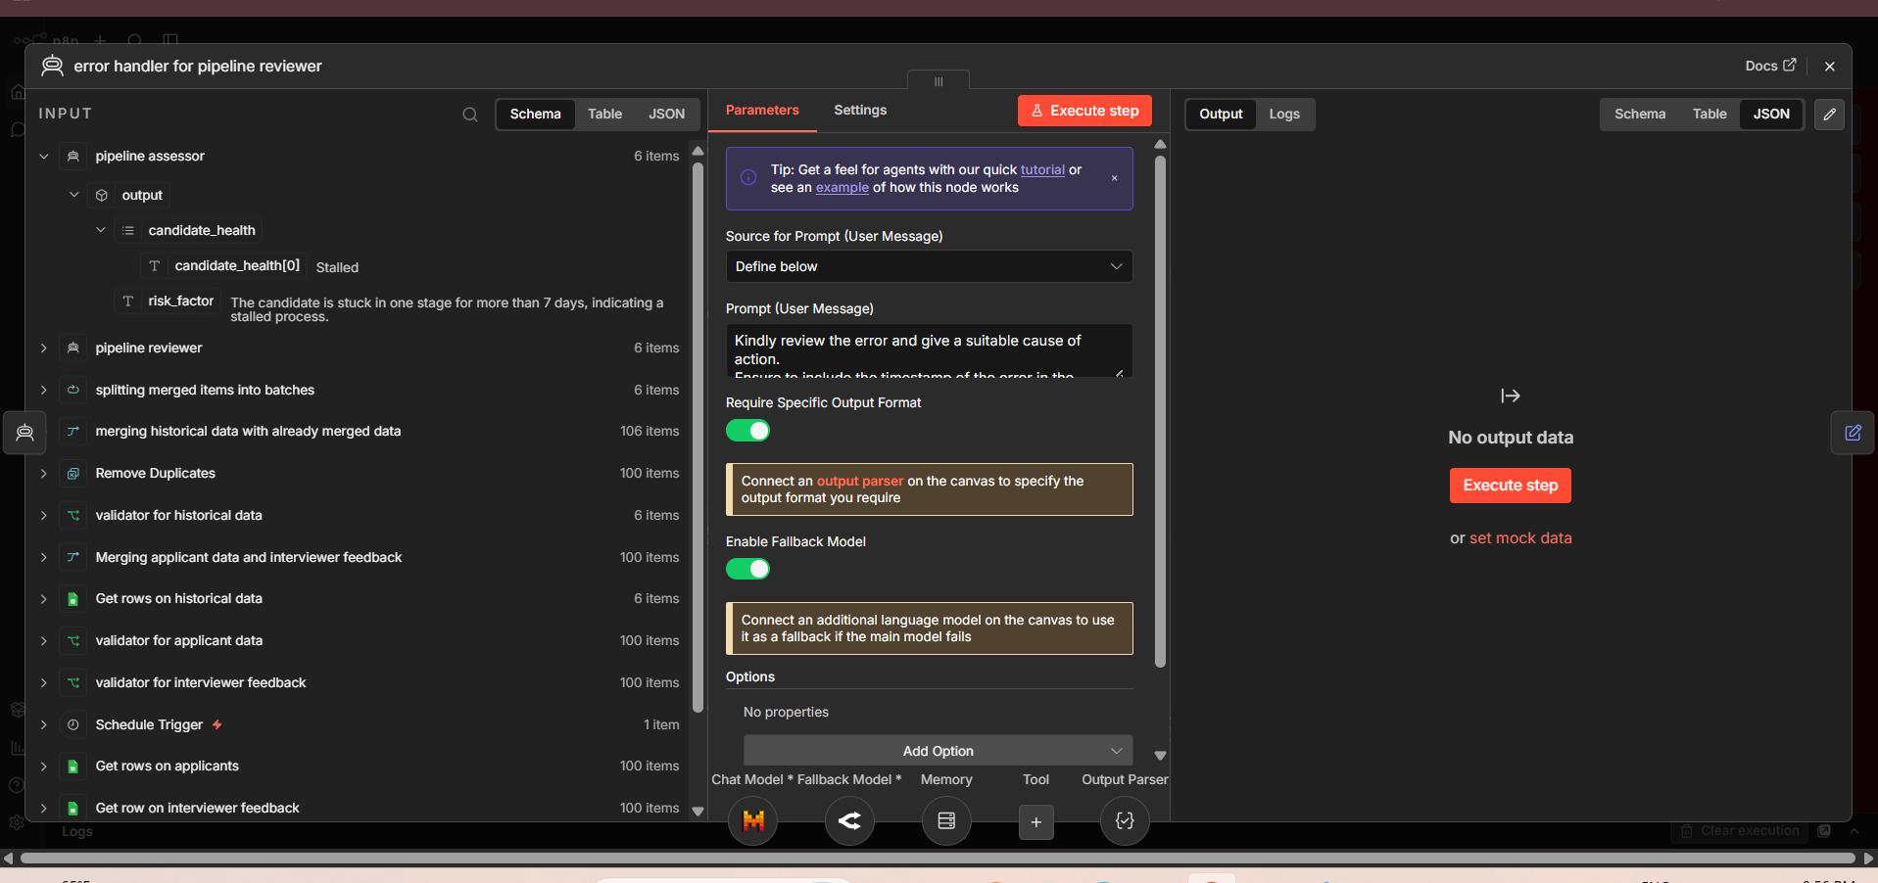

Slide 43
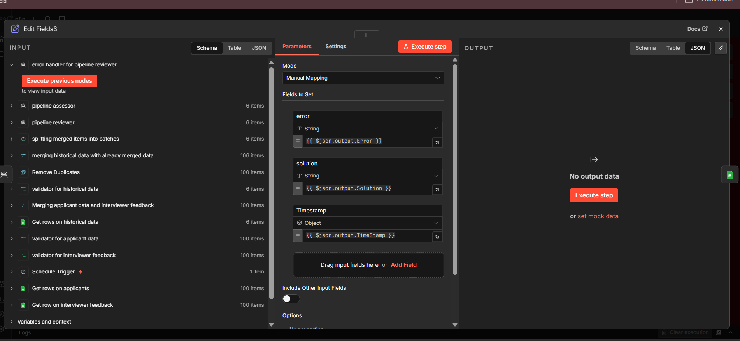

Slide 44
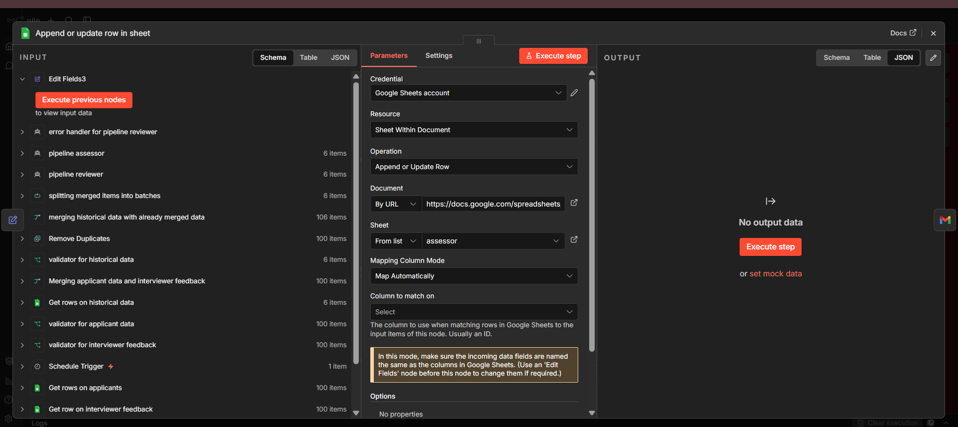

Slide 45
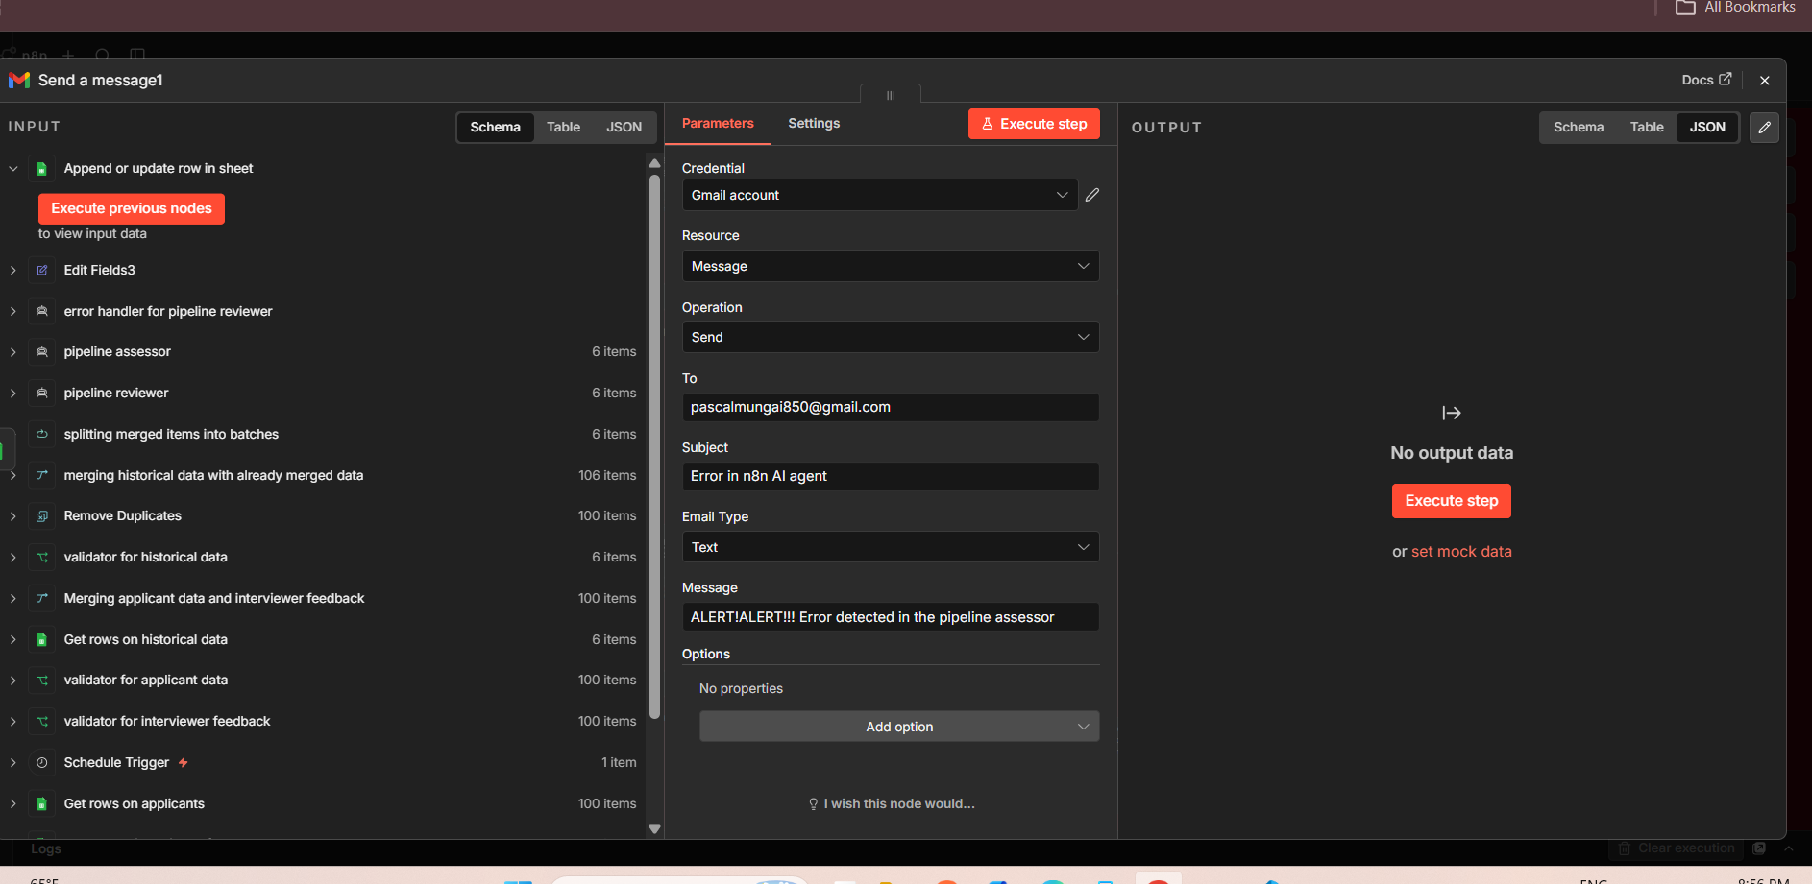

Slide 46
End-to-End Workflow Flow Summary
Schedule
Trigger
Fetch
Sheets Data
Validate
& Merge
Batch
Split (20)
Reviewer
Agent
Assessor
Agent
Route:
Healthy/Stalled
Strategizer
Sub-Workflow
Email
& Log

Slide 47
Recommended Workflow Enhancements
1. Real-Time Webhook Trigger
2. Slack / Teams Notifications
Replace the monthly schedule with a webhook trigger that fires every time a candidate stage changes in Google Sheets, enabling real-time monitoring.
Add a Slack or Microsoft Teams node alongside Gmail so hiring managers receive instant in-channel alerts when candidates stall.
3. Dashboard Aggregation Sheet
4. Candidate Scoring Node
Add a dedicated 'Pipeline Dashboard' sheet tab and an Append node after each run to build a time-series view of pipeline health metrics.
Insert a Code node after the assessor that assigns a numeric health score (0-100) per candidate enabling ranked reporting instead of binary labels.
5. Retry Queue for Stalled Records
6. Automated Calendar Invite
Add a Wait node + loop that re-checks stalled candidates after 48 hours to confirm resolution before archiving them in the historical sheet.
When a candidate is stalled, use a Google Calendar node to auto-schedule a review meeting with the hiring manager, eliminating manual follow-up.

Slide 48
Summary & Next Steps
Building a smarter, faster recruitment pipeline with AI automation
✔ 57-node workflow fully automates monthly recruitment pipeline reviews
✔ Three data sources merged, deduplicated, and processed by dual AI models
✔ Binary health classification (healthy / stalled) drives actionable downstream routing
✔ Recruit Strategizer sub-workflow delivers AI-authored HTML strategy reports via email
✔ Three-tier error handling ensures zero silent failures across the pipeline
→ Next: Implement webhook trigger, Slack alerts & candidate scoring for v2.0

